Slide 1
Modern Jukebox
Audio player

Slide 2
Contents
Introduction.
Problem Statement.
Modern Jukebox.
Challenges
Task 1.
Task 2.
Task 3.

Slide 3
Introduction
Jukebox were invented even before digital music existed.
Electronic and digital jukeboxes become prevalent in 1970s and 1980s.
Modern jukeboxes are fully computerized and stream music from the internet directly

Slide 4
Problem statement
It is mechanical so it has so much limitations.
When it gets older the machine parts get wearied.
It is the physical item so it occupy large space.

Slide 5
Modern Jukebox
It is the virtual jukebox so it has less limitations.
When it gets older it is works as a new one even we can update the previous versions
This jukebox is virtual so it occupy virtual space.

Slide 6
Challenges
Allows user to listen to live streamed music.
Browse through the artists and album or create a playlist.
Design jukebox that contains songs by various artists

Slide 7
Task 1:
It must contain a catalog of songs by various artists, The songs must be in the wav format.
The catalog can be categorized based on the album's artist, genre, or name.
The user must be able to search for music based on any of the categories mentioned.
Once a category is specified, an alphabetical search can be offered to the user to locate music

Slide 8
Task 2:
The jukebox should allow a user to create a playlist of songs.
Allow a user to add a song or album to the created playlist.
The user should be able to create multiple playlists and view the contents of the playlists

Slide 9
Task 3:
A user should now be able to play songs from the created playlists.
Display all the songs in the playlist along with the name of the song, album name
The user must be able to play any song from the playlist.
The user must be able to perform the reverse, forward, pause, resume and loop play of the songs in the playlist.

Slide 10
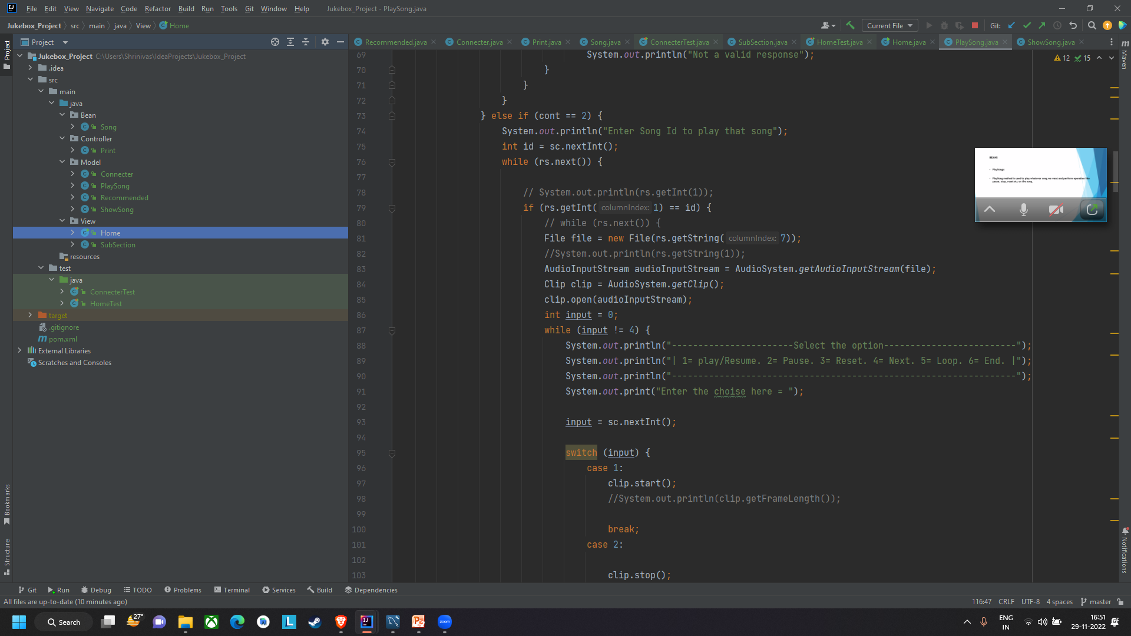
MVC Model

Slide 11
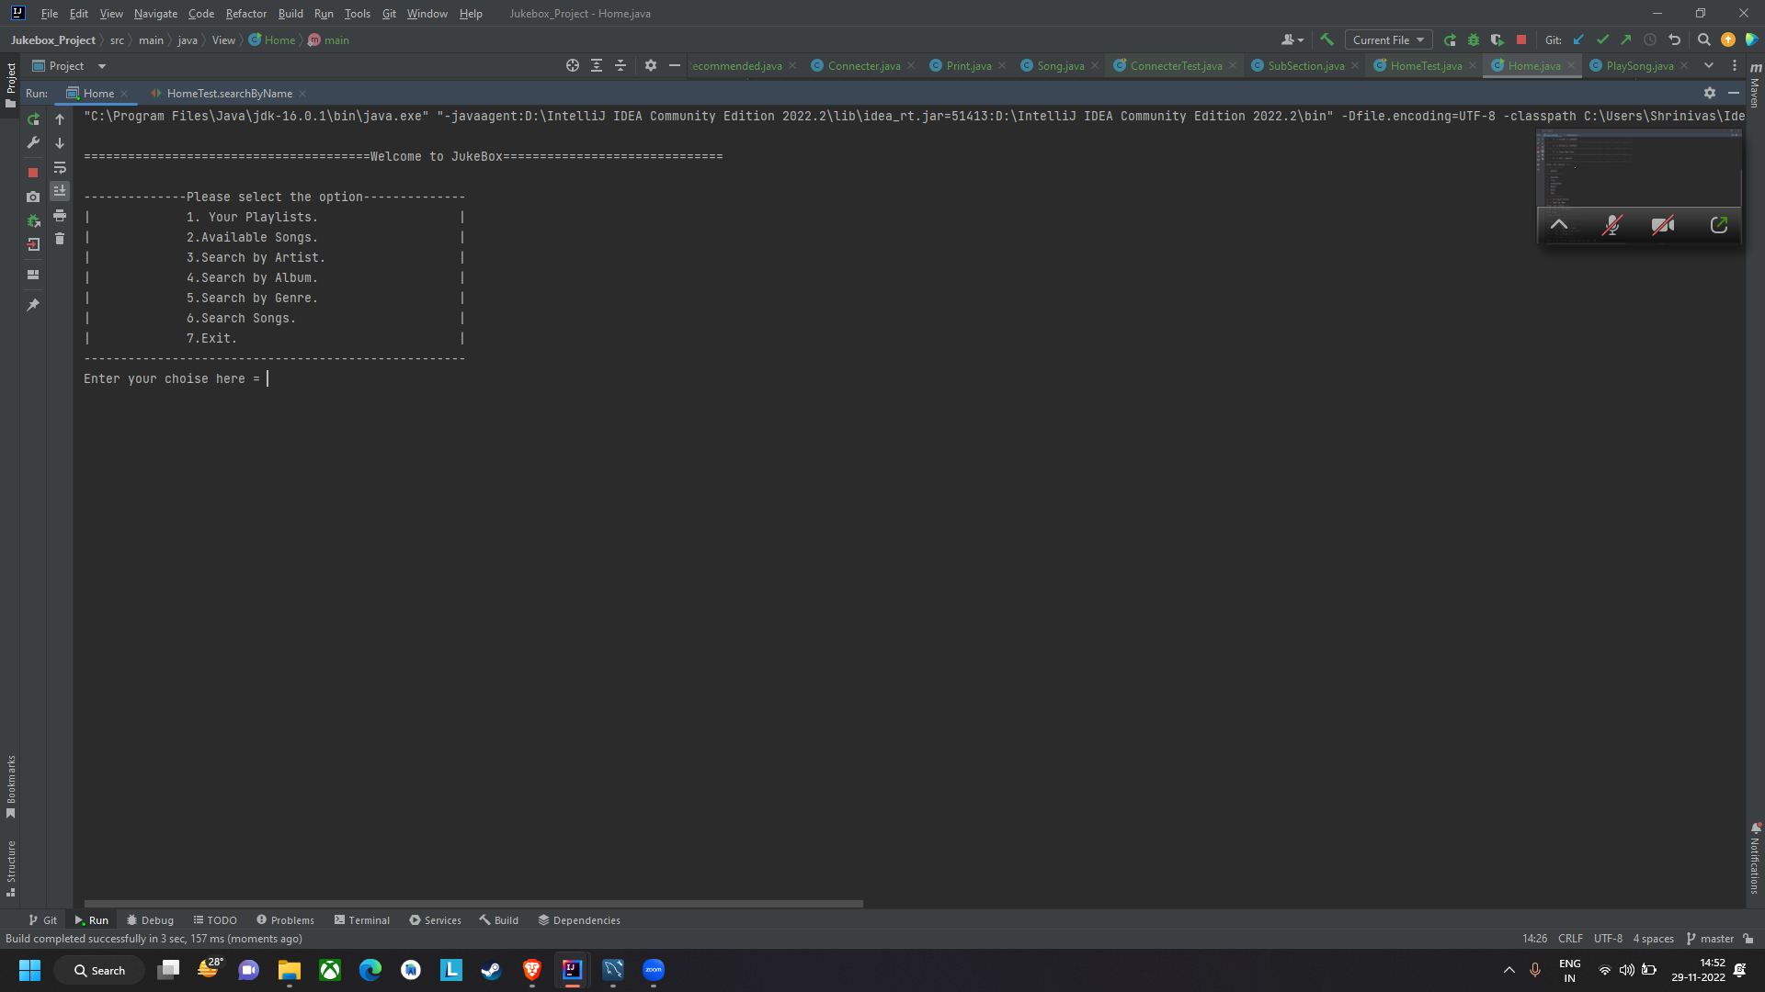

Slide 12
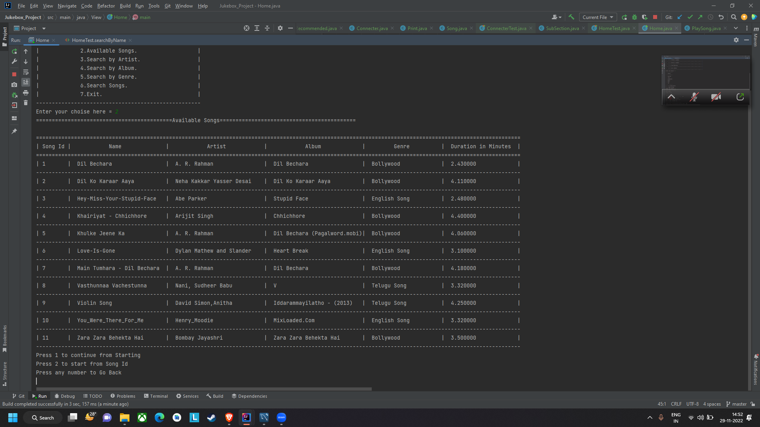

Slide 13
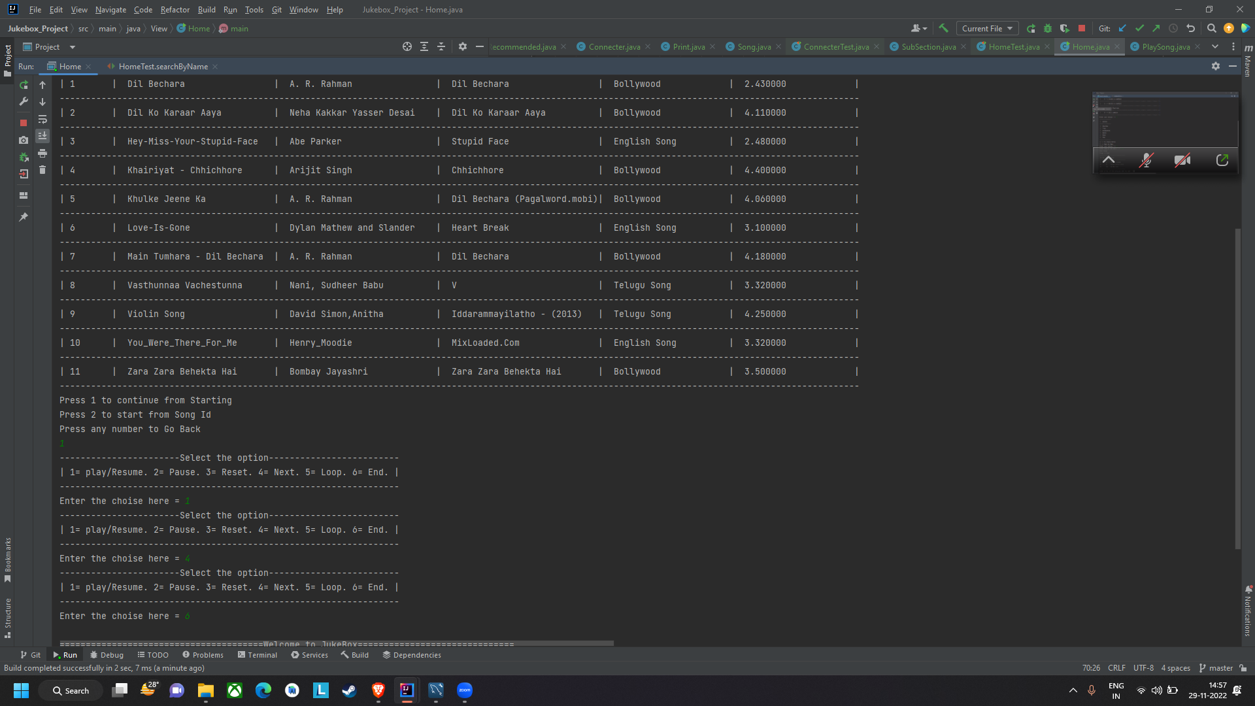

Slide 14
Let’s get into IntelliJ

